Slide 1
CSE 12 – Basic Data Structures and Object-Oriented Design Lecture 1
Greg Miranda & Paul Cao, Winter 2021
This lecture is being recorded

Slide 2
Fair Notice of Class Recording Announcement
Each class online lecture for CSE 12, including this one, will be recorded and made available to students asynchronously.

Slide 3
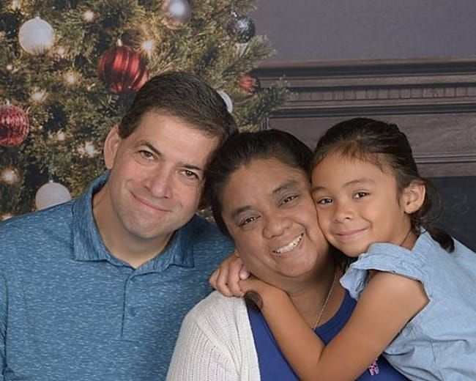
Greg Miranda
Started at UCSD in Summer 2018
Taught at private colleges (AICASD, UAT) before UCSD
Teaching Background:
5A/8B/11/12
Game Programming, Game Design, Web Programming
Background:
CE graduate from UCSD in ’96
20+ years as a Software Engineer
When I’m not teaching:
Consulting
Taekwondo

Slide 4
Announcements
Discussion starts tomorrow 9am, 10am, 11am, 12pm
Quiz 1 due Wednesday @ 8am
PA0 released today – set up Java development environment
PA1 released Wednesday – due 1/13, collaboration

Slide 5
Topics
Syllabus
Canvas
Questions?

